Slide 1

Stonecrest Ethics Board Community
Knowledge Is Power, When Power Of Knowledge Is Shared With People!
Proverbs 18:15
The mind of the prudent is ever getting knowledge, and the ear of the wise is ever seeking (inquiring for and craving) knowledge.

Slide 2
About US
We are a group of Stonecrest residents who are seeking out information about the ethical conduct of the Stonecrest city government in compliance with the City Charter. Stonecrest Ethics Board (SEB) exists for the purpose of education, investigation, and resolution of ethical concerns of the city governance. It is our hope the members/volunteers of the Stonecrest Ethics Board would research information about how our elected officials are using tax dollars to ensure it is used for the benefit of the community. We are going to Make Ethics Great Again - MEGA!
Psalm 119:66
Teach me good judgment, wise and right discernment, and knowledge, for I have believed (trusted, relied on, and clung to) Your commandments.

Slide 3
R. I. S. E.
Research and Information Sharing with Everyone
Research: Exam the issue for ascertaining all sides of the matter
Information: Communicate facts to make nonjudgmental decisions
Sharing: Distribute pertinent knowledge for equitable outcome
Everyone: Appropriate individuals related to particular case
Proverbs 2:6
For the Lord gives skillful and godly Wisdom; from His mouth come knowledge and understanding.

Slide 4
What is Ethics?
Personal Ethics
“Personal ethics refers to the ethics that a person identifies with in respect to people and situations that they deal with in everyday life.”
Professional Ethics
“Professional ethics refers to the ethics that a person must adhere to in respect of their interactions and business dealings in their professional life.”
Reference: Ministry of Business, Innovation and Employment. (2019). New Zealand Government. Retrieved from https://www.iaa.govt.nz/for-advisers/adviser-tools/ethics-toolkit/the-difference-between-personal-and-professional-ethics/).

Slide 5

Challenges in Local Government: Ethics
https://youtu.be/y9dAhmWp8rI

Slide 6
Government Ethics, Georgia
The Georgia Municipal Association (2010, July) states ethics in government consists of five elements.
Serve others, not ourselves
Use resources with efficiency and economy
Treat all people fairly
Use the power of our position for the well being of our constituents
Create an environment of honesty, openness and integrity
Reference: Georgia Municipal Association. (2010). Ethics in government: Charting the right course. Retrieved from https://www.thempc.org/eagenda/x/hrb/2013/JUNE%2012,%202013%20HISTORIC%20DISTRICT%20BOARD%20OF%20REVIEW%20SPECIAL%20CALLED%20MEETING%20on%20Wednesday,%20June%2012,%202013/864DC2DA-B8E1-43C6-875B-6B9F4B94F816.pdf

Slide 7
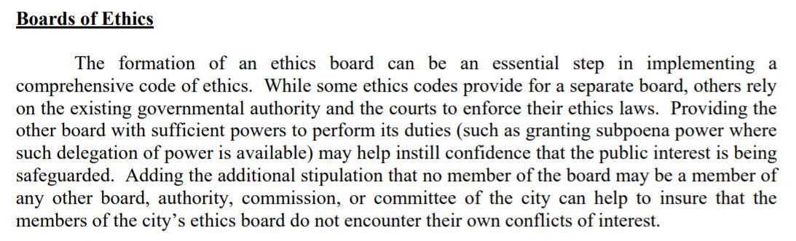
Government Ethics, Georgia, continue
Reference: Georgia Municipal Association. (2010). Ethics in government: Charting the right course, p. 43. Retrieved from https://www.thempc.org/eagenda/x/hrb/2013/JUNE%2012,%202013%20HISTORIC%20DISTRICT%20BOARD%20OF%20REVIEW%20SPECIAL%20CALLED%20MEETING%20on%20Wednesday,%20June%2012,%202013/864DC2DA-B8E1-43C6-875B-6B9F4B94F816.pdf

Slide 8
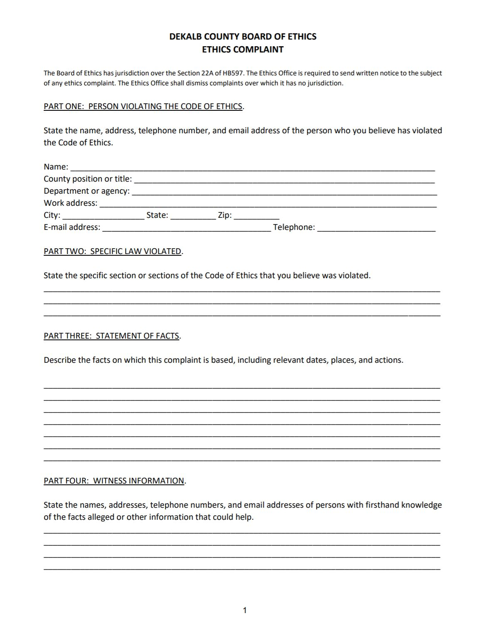
DeKalb County Board of Ethics, Complaint Form, p. 1
Reference: DeKalb County Georgia. (2019). DeKalb county ethics complaint form. DeKalb county board of ethics. Retrieved from http://www.dekalbcountyethics.org/file-a-complaint/

Slide 9
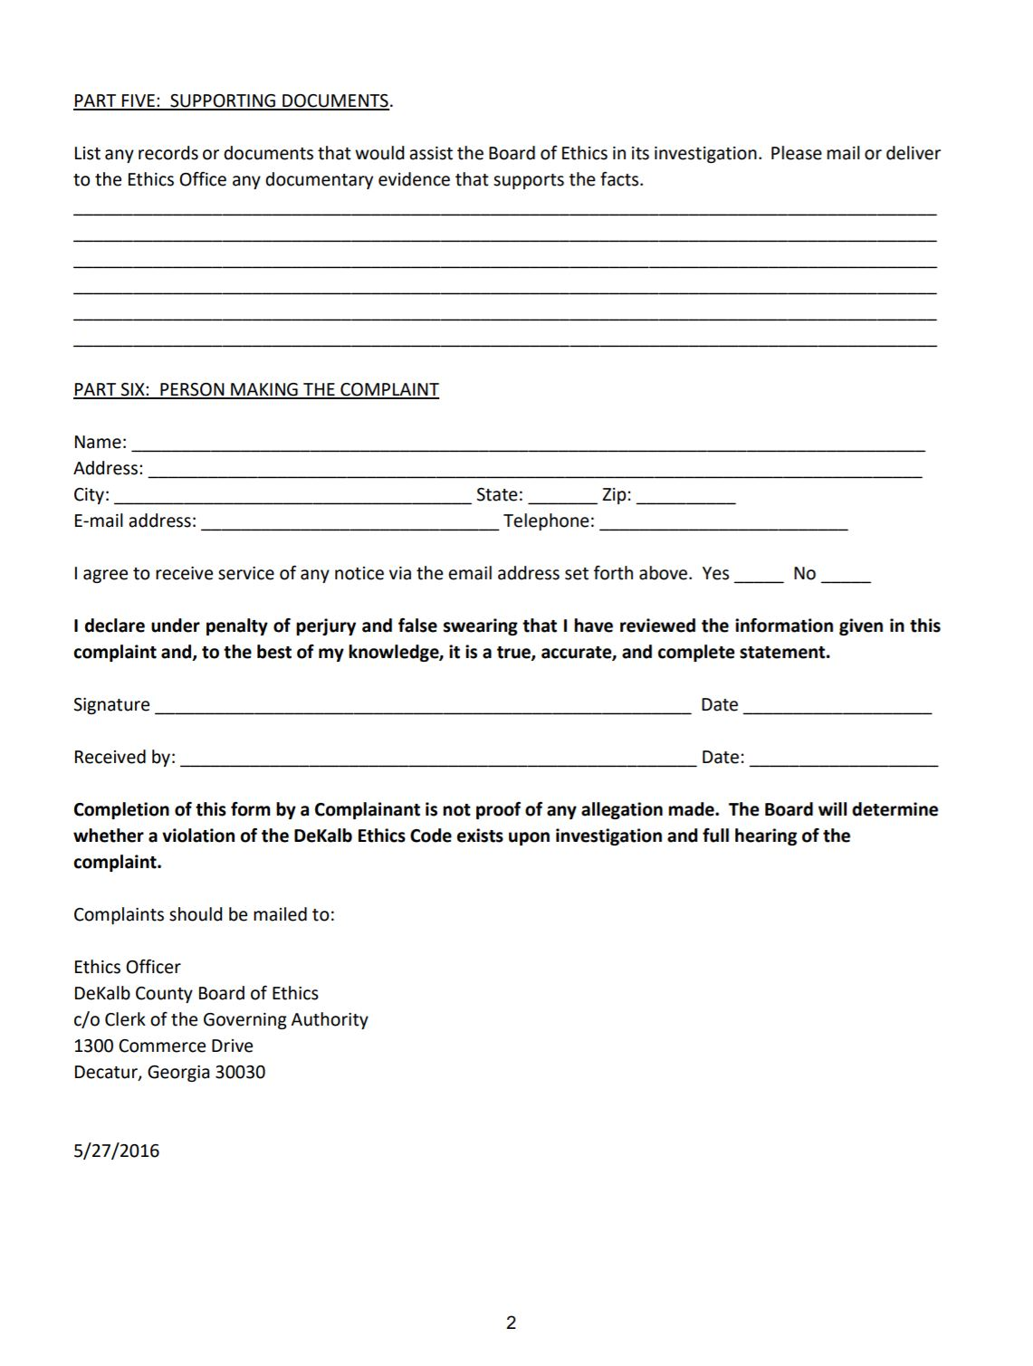
DeKalb County Board of Ethics, Complaint Form, p. 2
Reference: DeKalb County Georgia. (2019). DeKalb county ethics complaint form. DeKalb county board of ethics. Retrieved from http://www.dekalbcountyethics.org/file-a-complaint/

Slide 10
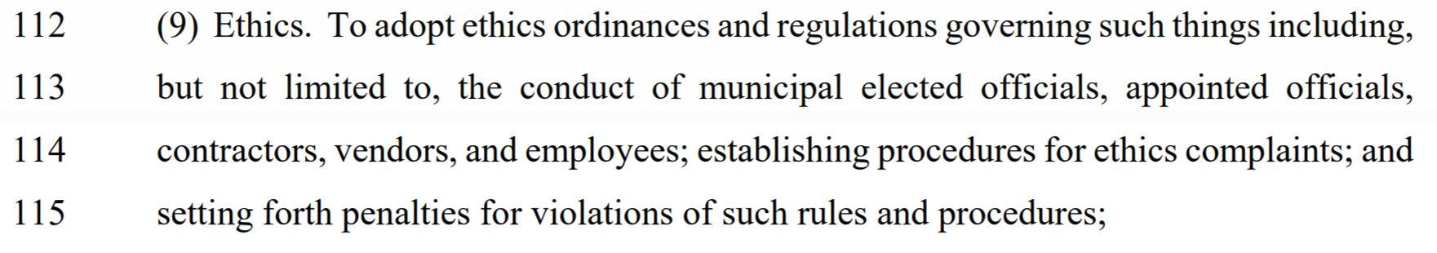
Stonecrest Ethics Board: City Charter
Reference: Senate Bill 208, 2015 Senators Ramsey, Sr. of the 43rd, Jones of the 10th, Davenport of the 44th, Henson of the 41st and Butler of the 55th. (GA. 2015). City of Stonecrest Charter, p. 4. Retrieved from https://www.stonecrestga.gov/charter.php

Slide 11
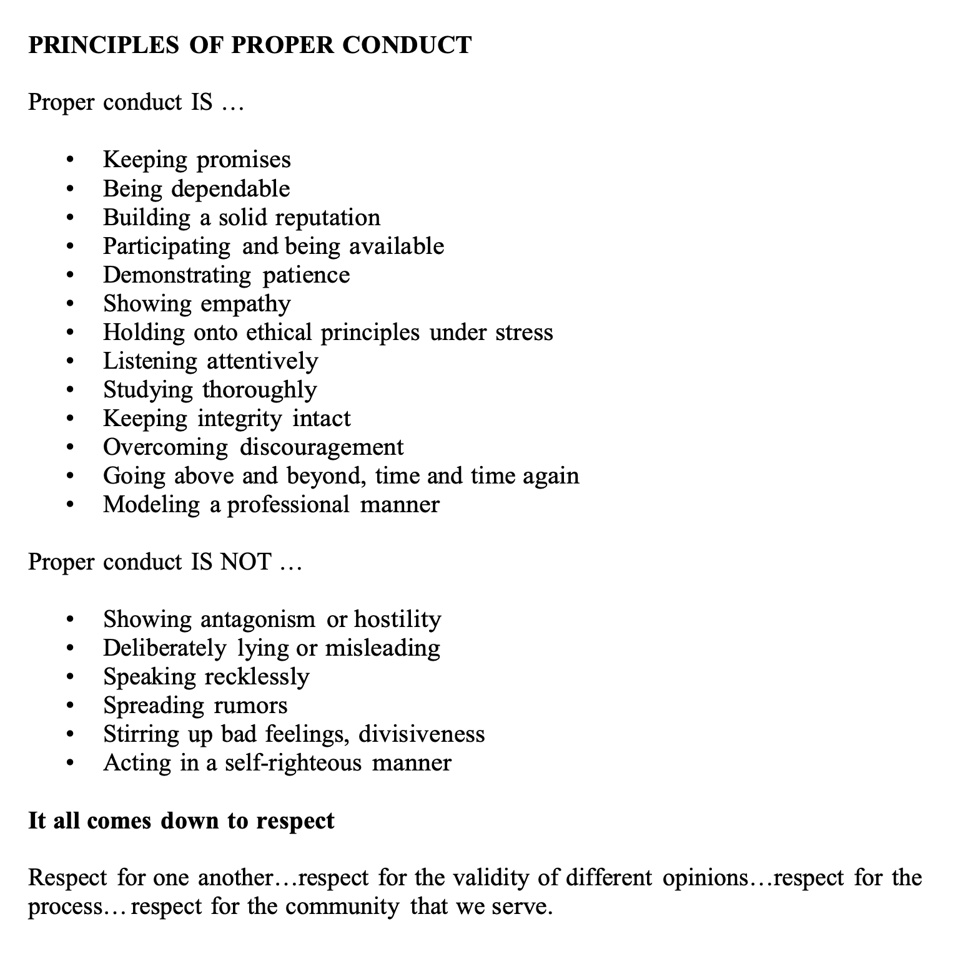
Rifle Colorado. (2016, August 3). Code of Conduct for Elected Officials. Adopted by City Council, Resolution No. 11, Series of 2016, p. 16. Retrieved from https://www.rifleco.org/DocumentCenter/View/9147/Code-of-Conduct-for-Elected-Officials?bidId=

Slide 12
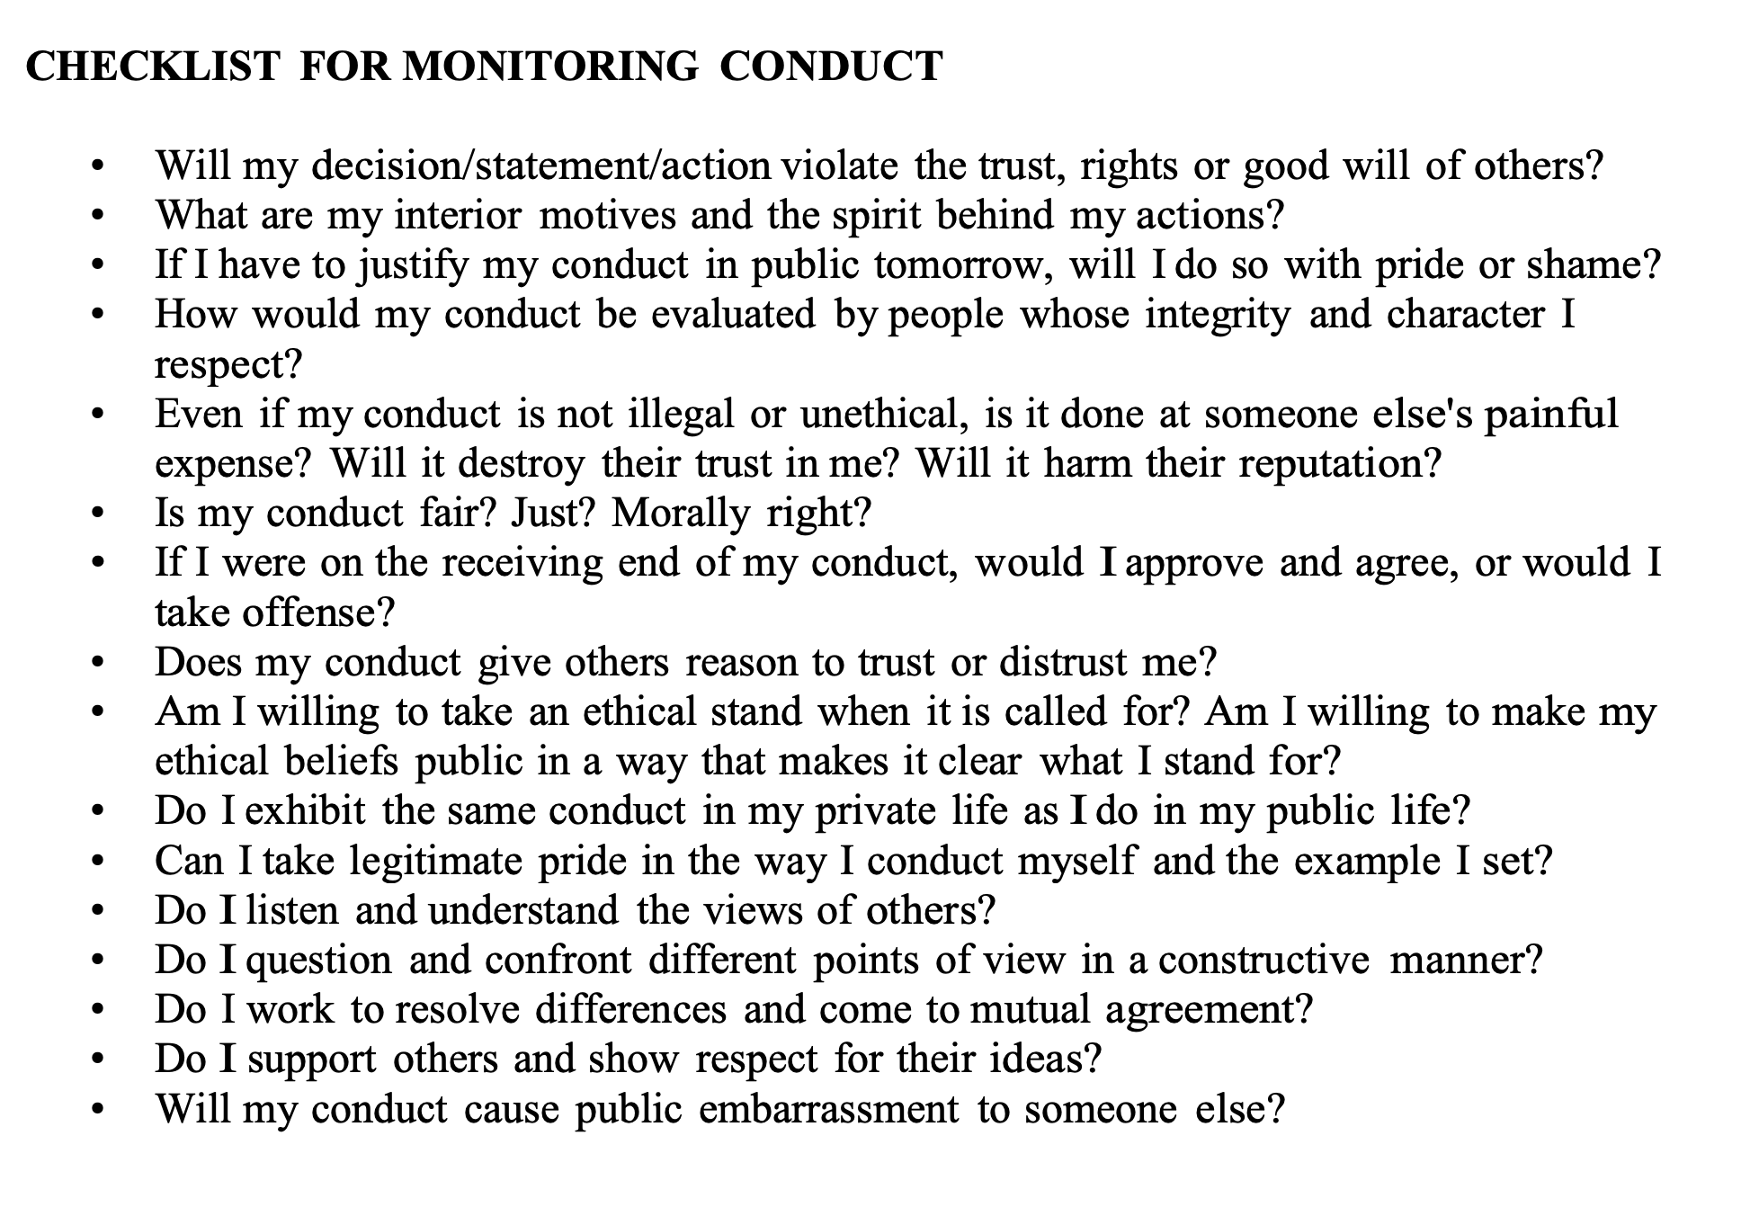
Rifle Colorado. (2016, August 3). Code of Conduct for Elected Officials. Adopted by City Council, Resolution No. 11, Series of 2016, p. 17. Retrieved from https://www.rifleco.org/DocumentCenter/View/9147/Code-of-Conduct-for-Elected-Officials?bidId=

Slide 13
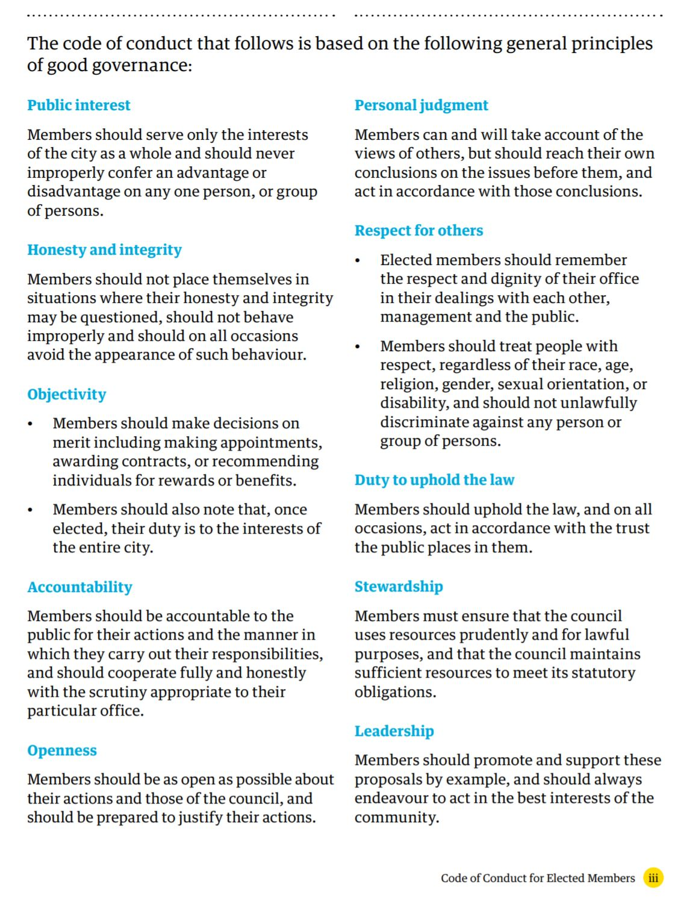
Code of Conduct for Elected Officials
Reference: Me Heke Ki Poneke. (2015). Code of conduct for elected members. Absolutely positively Wellington city council. Retrieved from https://wellington.govt.nz/~/media/your-council/mayor-and-councillors/files/elected-codeofconduct.pdf

Slide 14
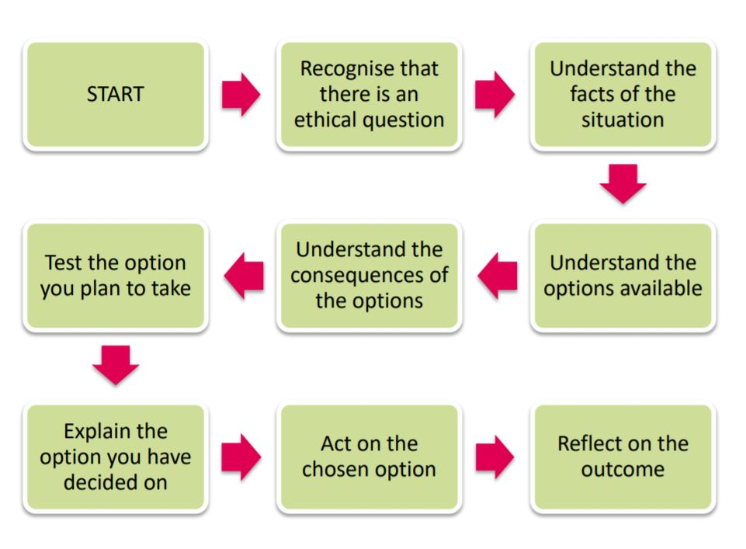
Ethical Methodology
Reference: Immigration Advisers Authority. (2020). Solving ethical problems. Ministry of business, innovation and employment - New Zealand Government. Retrieved from https://www.iaa.govt.nz/for-advisers/adviser-tools/ethics-toolkit/solving-ethical-problems/

Slide 15
Robert’s Rules of Order
Rules Governing an Organization
II. Purposes of Parliamentary Procedure
III. Basic Principles of Parliamentary Procedure
IV. Typical Order of Business
V. Role of the Presiding Officer
VI. General Procedure for Handling a Motion
VII. General Rules of Debate
VIII. Motions in Ascending Order of Precedence
IX. Incidental Motions (Questions of procedure that arise out of other motions and must be considered before the other motion)
X. Main Motions That Bring a Question Back Before the Assembly
XI. Voting
Reference: Douglas N. Case. (2001). Parliamentary Authority: Robert's Rules of Order, Newly Revised, Tenth Edition. San Diego State University.

Slide 16
Butterfly Journey Human Services, LLC
Stonecrest Ethics Board Community
Mailing Address: Post Office Box 392801, Snellville, Georgia 30039
Email: StonecrestGaEthicsBoard@gmail.com (Stonecrest Georgia Ethics Board Community)
Email: ButterflyJourneyHS@gmail.com (Butterfly Journey Human Services, LLC)
Twitter: @StonecrestGAEthicsBoard
Instagram: @StonecrestGAEthicsBoard
Telephone: 404.216.0680
www. StonecrestGaEthicsBoard.webnode.com
www.ButterflyJourney.org

